Slide 1
Should the American people pay to warehouse consumer goods? Re-examining the Research Value of Constituent Gifts to the U.S. President and Vice President
Dr. Eric Carlos Stoykovich
Project Archivist, Special Collections
University of Maryland libraries

Slide 3
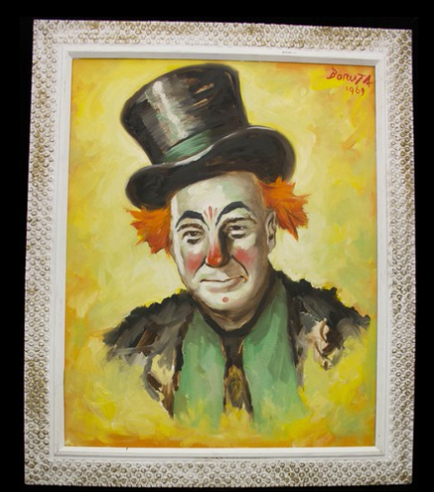
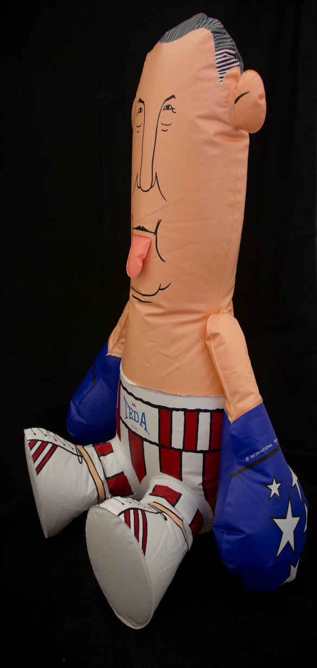
“Rare” Constituent Gifts, from Spiro T. Agnew papers,
UMD libraries

Slide 4
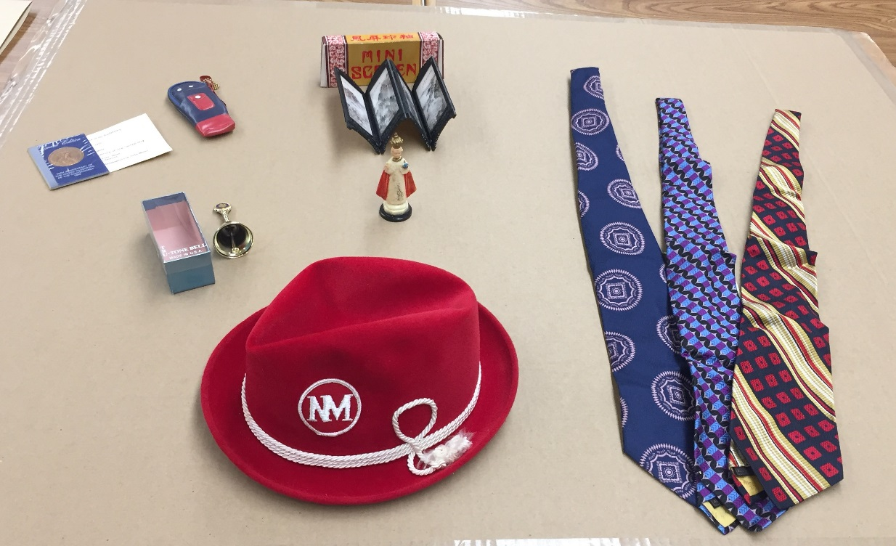
“Commonplace”Constituent Gifts,
from Spiro T. Agnew papers,
UMD libraries

Slide 5
Commercial Books without Inscriptions
William Jefferson Clinton Library
2 vols., Dolores Cannon’s Conversations with Nostradamus (first published 1992)
An issue of American Heritage – The Magazine of History
Paperback book Nicotina (in Spanish) by L. Ventura Fernandez

Slide 6
Reduce Cost of Storing Presidential Gifts
Could more gifts be donated by the White House to charity?
Could an appraisal strategy be adopted which accounts for the Presidential Records Act?
Could a high-quality digital photograph substitute as a record of constituent gifts?

Slide 7
Questions?
Dr. Eric C. Stoykovich
University of Maryland libraries
estoyko@umd.edu

